Slide 1
Generative Models III: Diffusion and Autoregressive Models Exploring Diffusion Processes and Pixel-Based Autoregressive Models

Slide 2
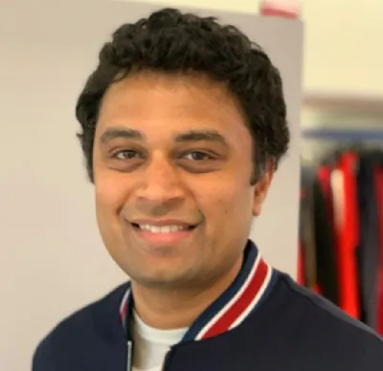
Harish Kashyap: harish@pandita.ai
An Entrepreneur and an AI SME at MIT Horizon in machine learning, robotics, big data, Gen AI and signal processing.
Over a decade of experience as a researcher across various industries, including Amazon Robotics, KLA Tencor and BBN Technologies.
Career highlights include leading the development of AI-driven algorithms that interact with robotic systems.
Founder of two companies, Mysuru Consulting Group(MCG) and Pandita AI.
GitHub: https://github.com/harishkashyap
LinkedIn: https://www.linkedin.com/in/hkashyap/

Slide 3
Understanding Diffusion Processes in Generative Modeling
Definition: A diffusion process models data by gradually adding noise and then learning to reverse the noise to recover the original data.
Key Steps:
Forward Process: Incrementally corrupting data with Gaussian noise.
Reverse Process: Learning a denoising model to reconstruct the data.
Applications:
High-quality image and video generation
Data imputation and inpainting
Diagram: Show a simple pipeline of adding noise (forward) and denoising (reverse).

Slide 4
Autoregressive Models
What Are Autoregressive Models?
Predict future data points based on previous ones.
Model joint probability as a product of conditionals: P(x)=P(x1)P(x2∣x1)...P(xn∣x1,...,xn−1)P(x) = P(x_1)P(x_2|x_1)...P(x_n|x_1, ..., x_{n-1})P(x)=P(x1​)P(x2​∣x1​)...P(xn​∣x1​,...,xn−1​).
Key Examples:
PixelRNNs:
Recurrent neural network applied pixel-by-pixel.
Captures dependencies in image data.
PixelCNNs:
Convolutional network operating on pixels.
Faster than PixelRNNs while preserving dependencies.
Visual: Side-by-side diagrams of PixelRNN and PixelCNN architectures.

Slide 5
Notebook: Simple Diffusion Model for Image Generation
Key Concepts:
Noise Scheduling:
Define how noise is added at each timestep.
Use linear or cosine schedules for effective noise variance.
Denoising Process:
Train a neural network to predict clean data from noisy samples.
Diffusion Loss:
Measure reconstruction error between denoised output and original data.
Practical Implementation:
Generate synthetic data using forward and reverse processes.
Demonstrate step-by-step coding in Python.
Visuals:
Annotated screenshots of notebook code.
Example of generated images at different diffusion steps.

Slide 6
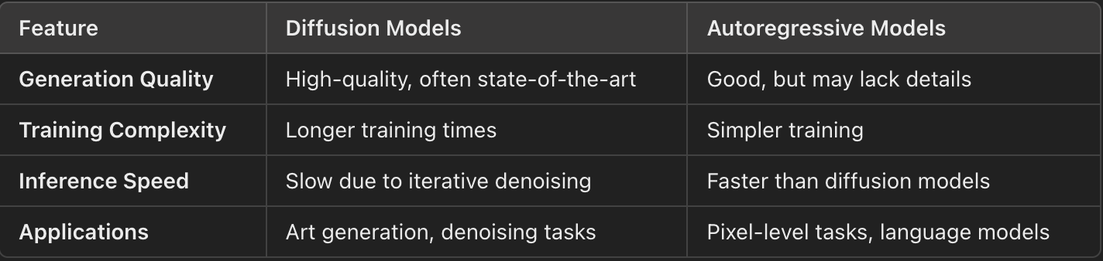
Comparison of Generative Models

Slide 7
Summary
Diffusion Models:
Leveraging noise to generate high-quality data.
Autoregressive Models:
Modeling data as a sequence for efficient training.
Practical Notebook:
Implementation highlights noise scheduling and denoising in diffusion models.
Key Takeaway: Diffusion models and autoregressive models excel in different domains, offering complementary approaches to generative modeling.

